Slide 1
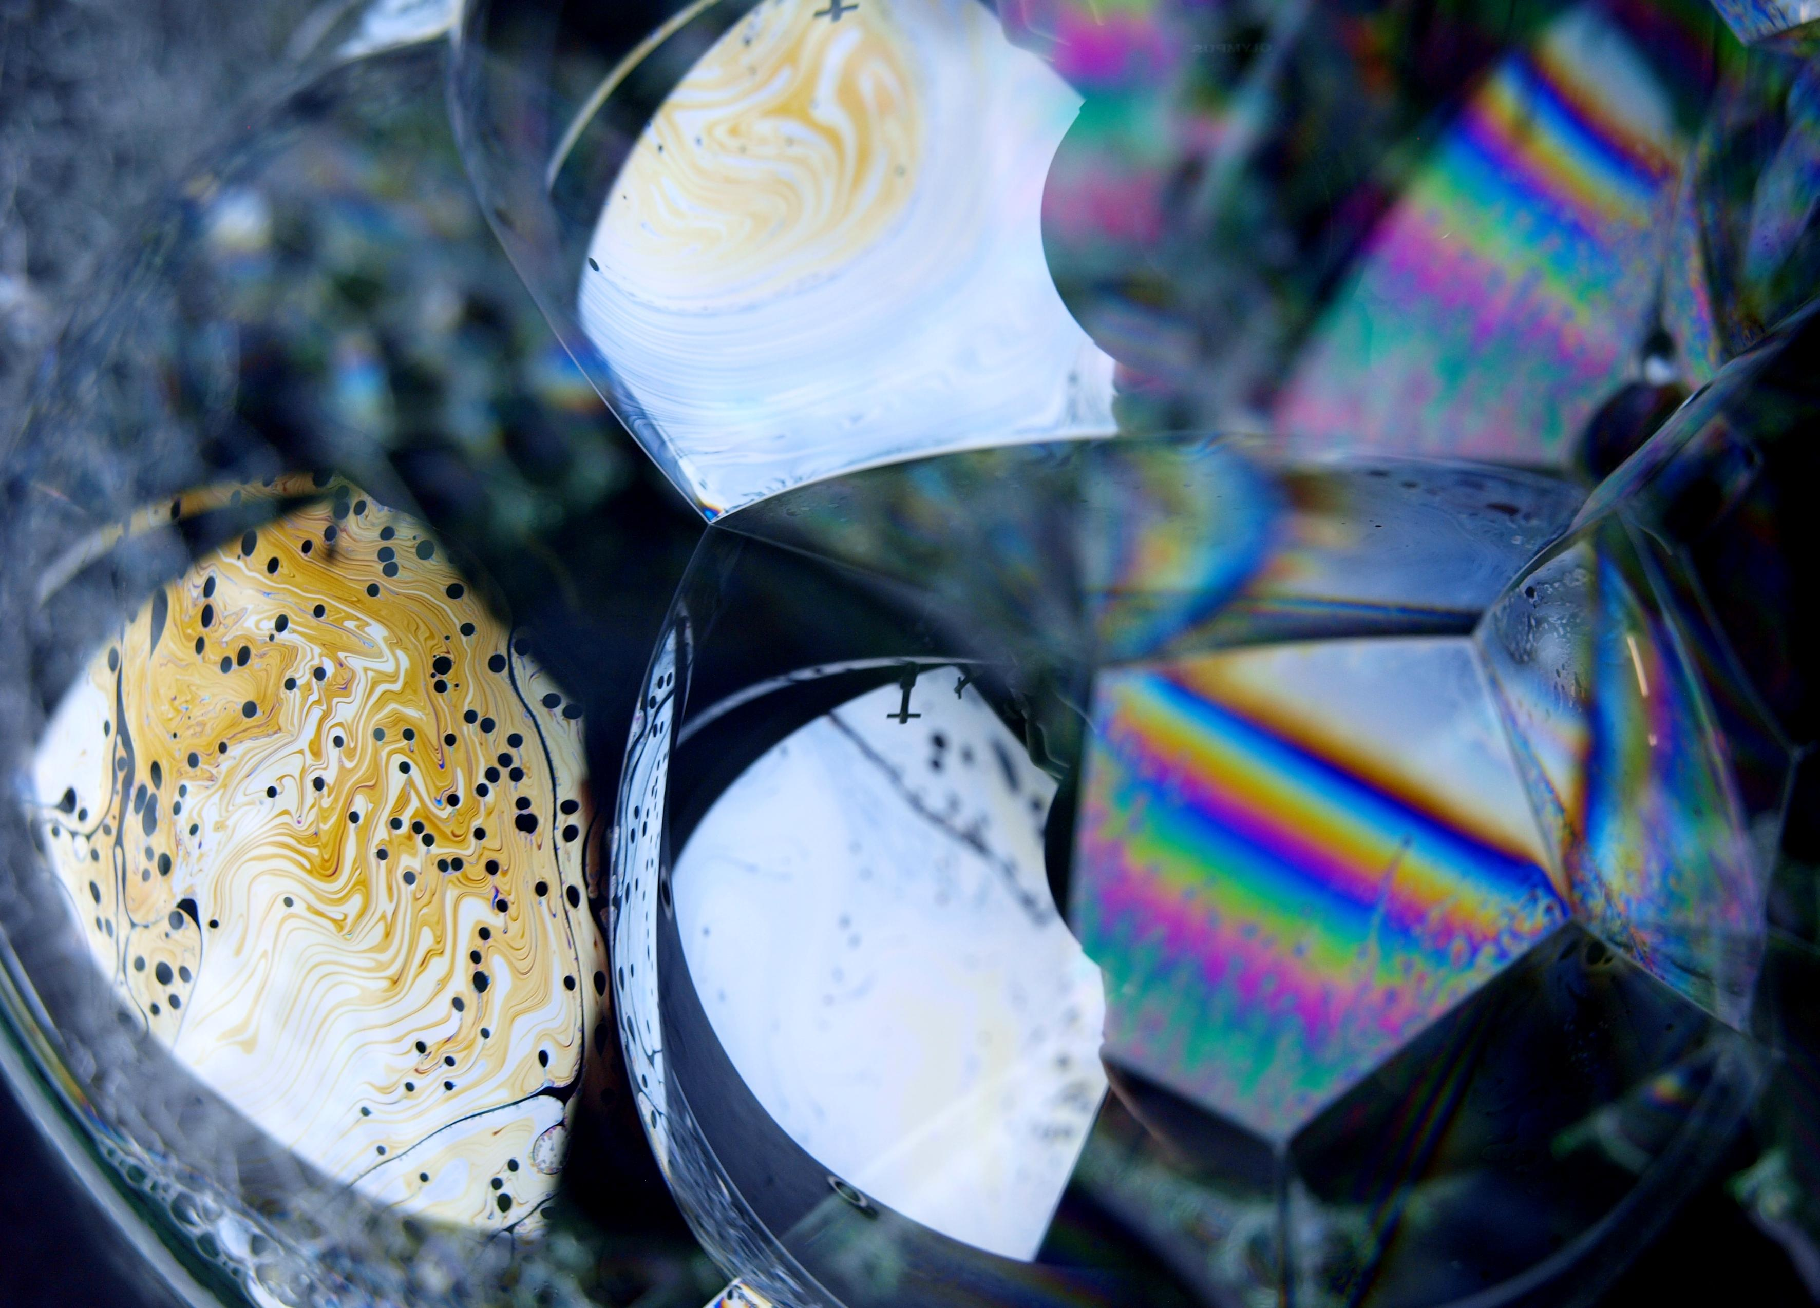
Surfactant System Selection to Generate foam for EOR Application
AmirHosein Valiollahzadeh
Maura Puerto
Jose Lopez
Astron Liu
Lisa Biswal
George Hirasaki

Slide 2
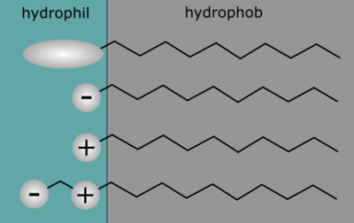
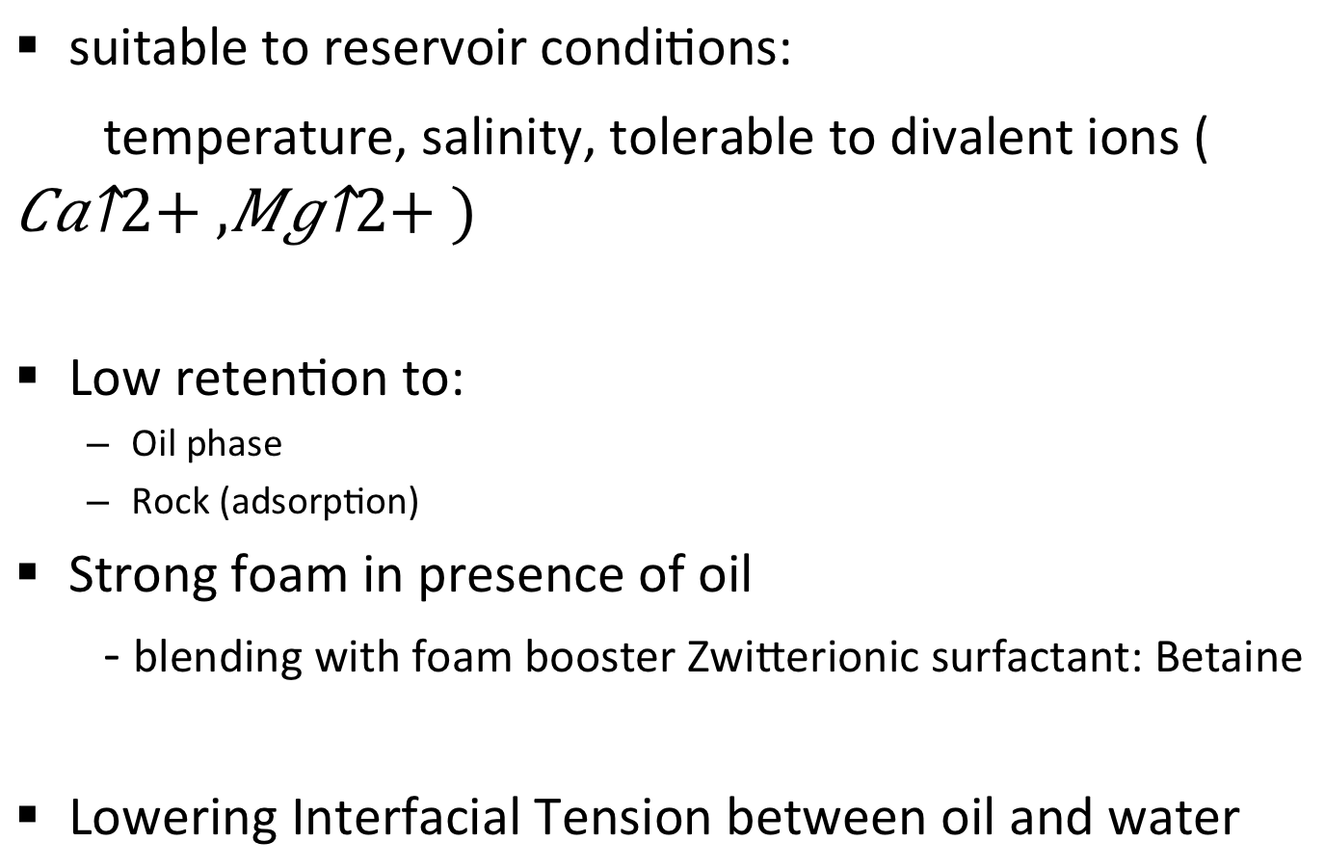
Desired Surfactant system
suitable to reservoir conditions:
temperature, salinity, tolerable to divalent ions (${Ca}^{2+},{Mg}^{2+})$
Low retention to:
  Oil phase
  Rock (adsorption)
Strong foam in presence of oil
- blending with foam booster Zwitterionic surfactant: Betaine
Lowering Interfacial Tension between oil and water

Slide 3
List of surfactants in this study
1- Alpha Olefin Sulfonate (AOS _{C14-16})
-widely used but not tolerable with divalent ions
2- Lauryl and Myristyl Betaine (LB)
-known as a foam booster
3- Orthoxylene Sulfonate- C24 (OXS)
-more hydrophobic will decrease IFT
4- Anionic surfactant (A)
-proprietary surfactant that may also help reduce IFT

Slide 4
Injection Water and Formation Brine
Ion composition in mg/l
ions | Injection Water | Formation Brine | Sea Water*
HCO₃⁻ | 402 | 834 | 140
Cl⁻ | 20,140 | 86,291 | 18,980
S0₄²⁻ | 201 | 595 | 2,649
Ca²⁺ | 1,536 | 12,224 | 400
Mg²⁺ | 826 | 2,189 | 1,262
Na⁺,K⁺ | 9,970 | 38,336 | 10,556
Total Salinity mg/l | 33,070 | 140,470 | 34,483
*Geochemistry of oilfield waters By A. Gene Collin

Slide 5
Surfactant Phase Behavior
Phase behavior Experiments:
Blend Scan (vary ratio of surfactants) to obtain the optimal blend
  - aqueous
  - n-octane
  - Crude oil
Salinity Scan (vary ion concentration) to determine the optimal salinity

Slide 6
Crude Oil – odor and treatment
Crude Oil Issues – odor and treatment
Removing Mercaptan as well as other possible contaminants
Molecular Sieve used:
SIGMA-ALDRICH 4Å type
composition:
1 Na₂O: 1 Al₂O₃: 2.0 ± 0.1 SiO₂: x H₂O.
Effective pore opening :
4Å
Adsorbed species:
SO₂, CO₂, H₂S, C₂H₄, C₂H₆, and C₃H₆

Slide 7
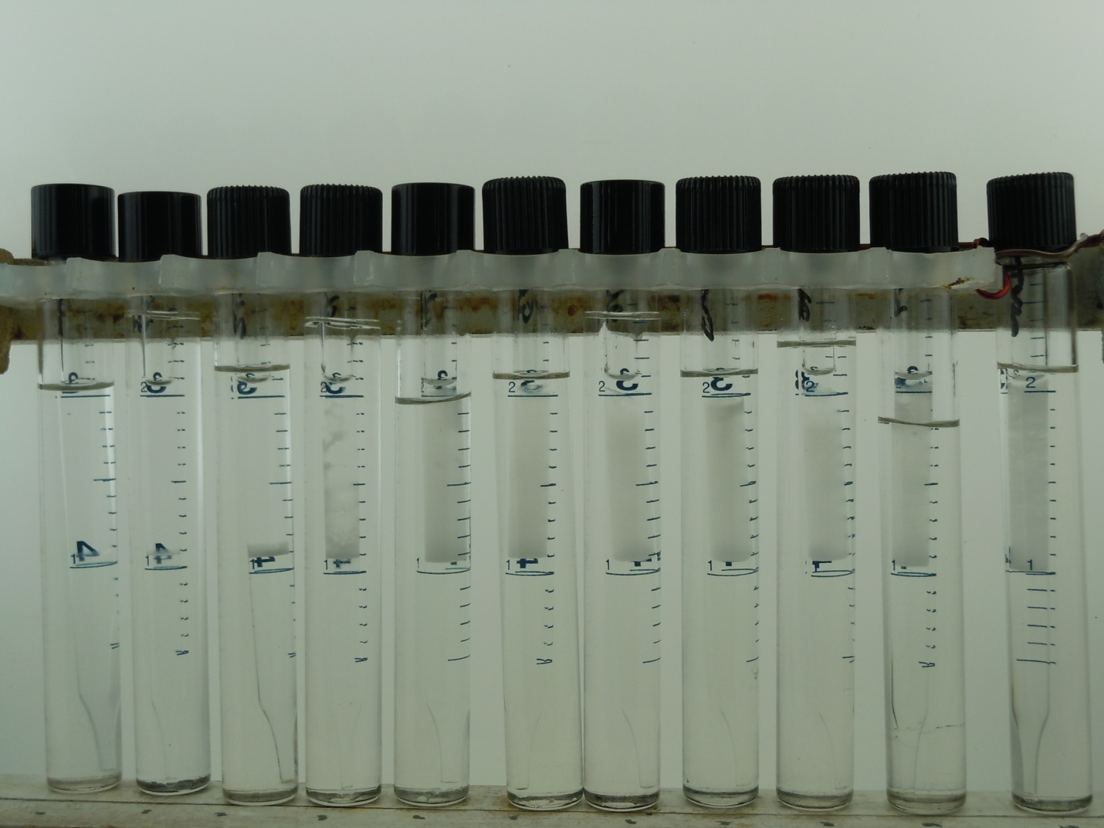
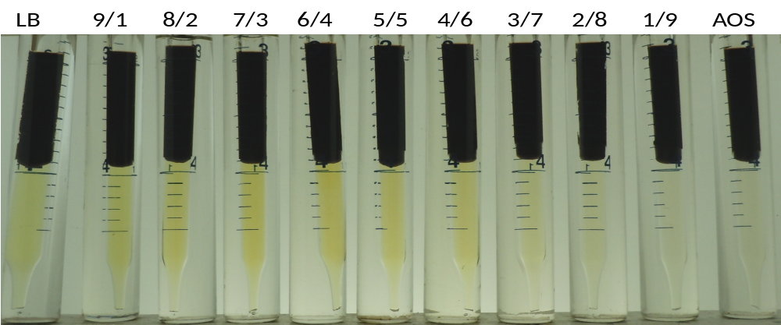
LB:AOS Blend Scan in Injection Water with n-Octane and crude oil.
2% overall surfactant concentration. WOR~1. 60°C
LB 9/1 8/2 7/3 6/4 5/5 4/6 3/7 2/8 1/9 AOS
n-Octane
Winsor Type I:
Lower phase micro-emulsion
Crude oil

Slide 8
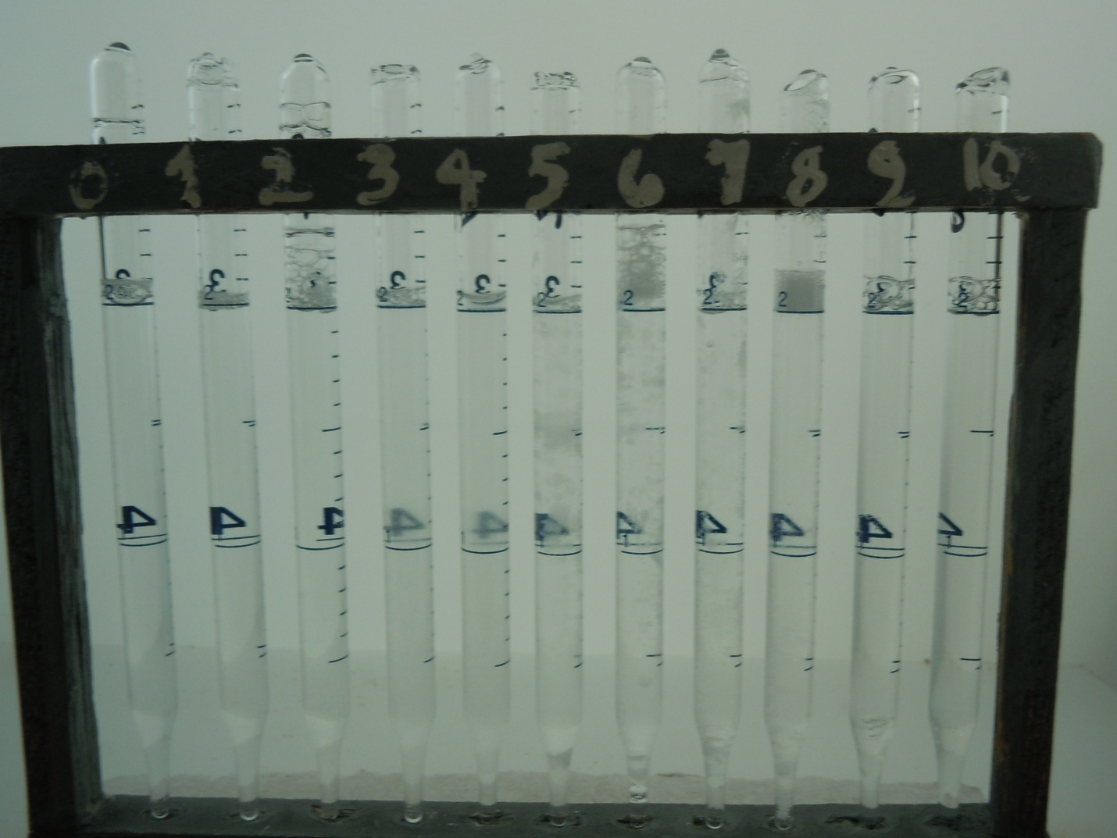
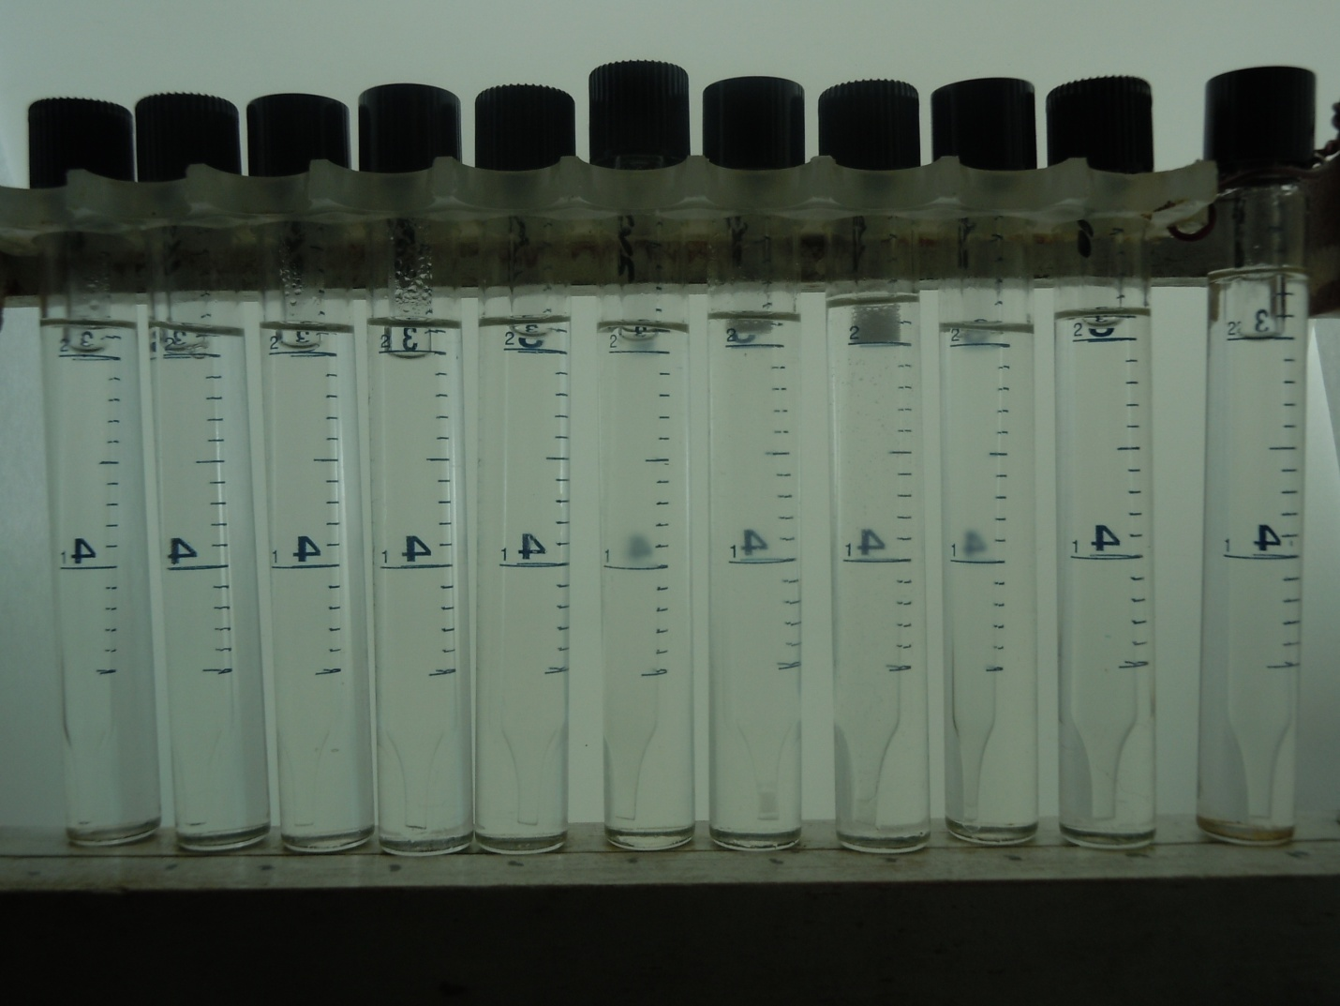
Aqueous blend scan LB:AOS in Injection water. 1% surfactant concentration
Injection composition
LB 9/1 8/2 7/3 6/4 5/5 4/ 6 3/7 2/8 1/9 AOS
25°C
60°C

Slide 9
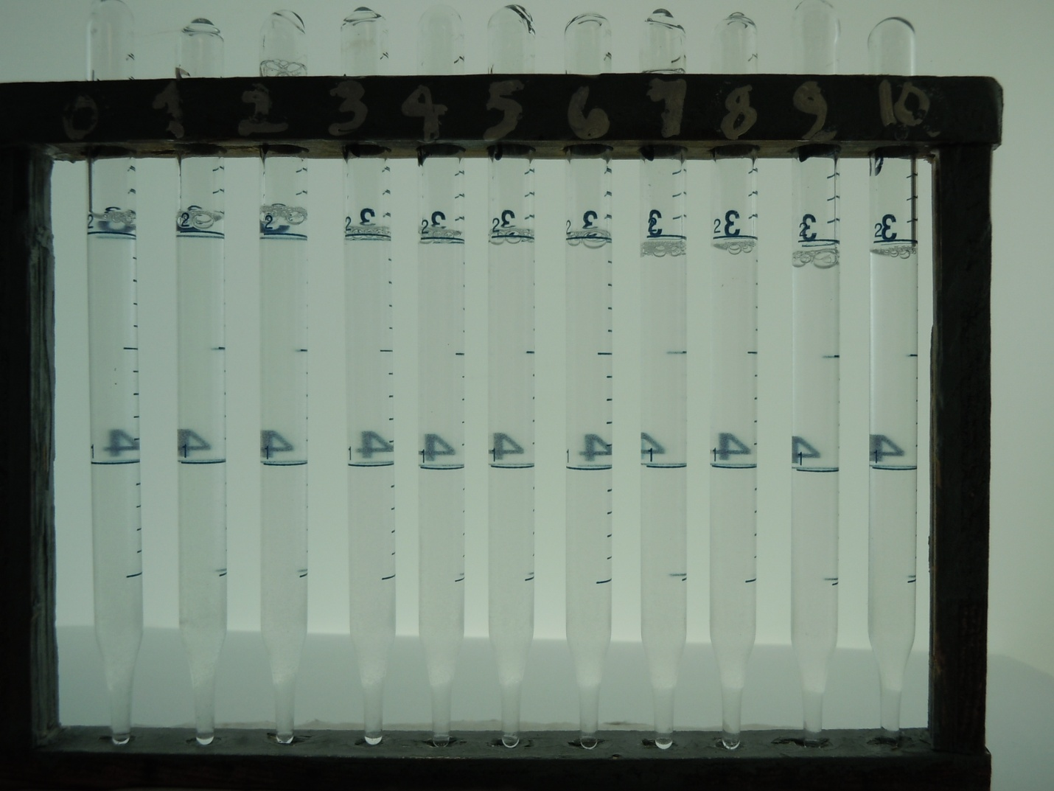
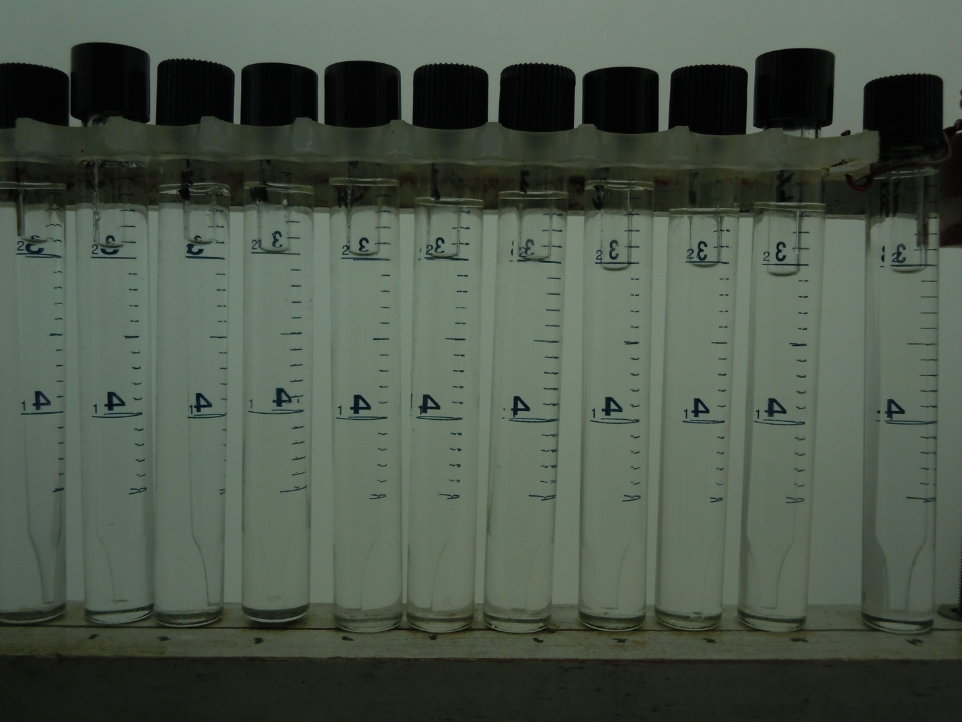
7:3 LB:AOS Aqueous Salinity Scan from Injection Water to Formation Brine. 1% Overall Surfactant Concentration
Inj 9/1 8/2 7/3 6/4 5/5 4/6 3/7 2/8 1/9 FB
25°C
60°C

Slide 10
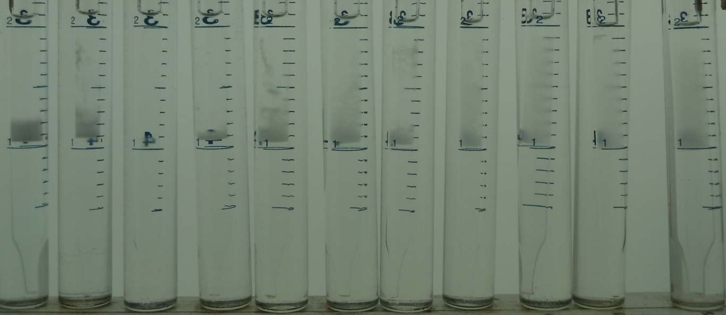
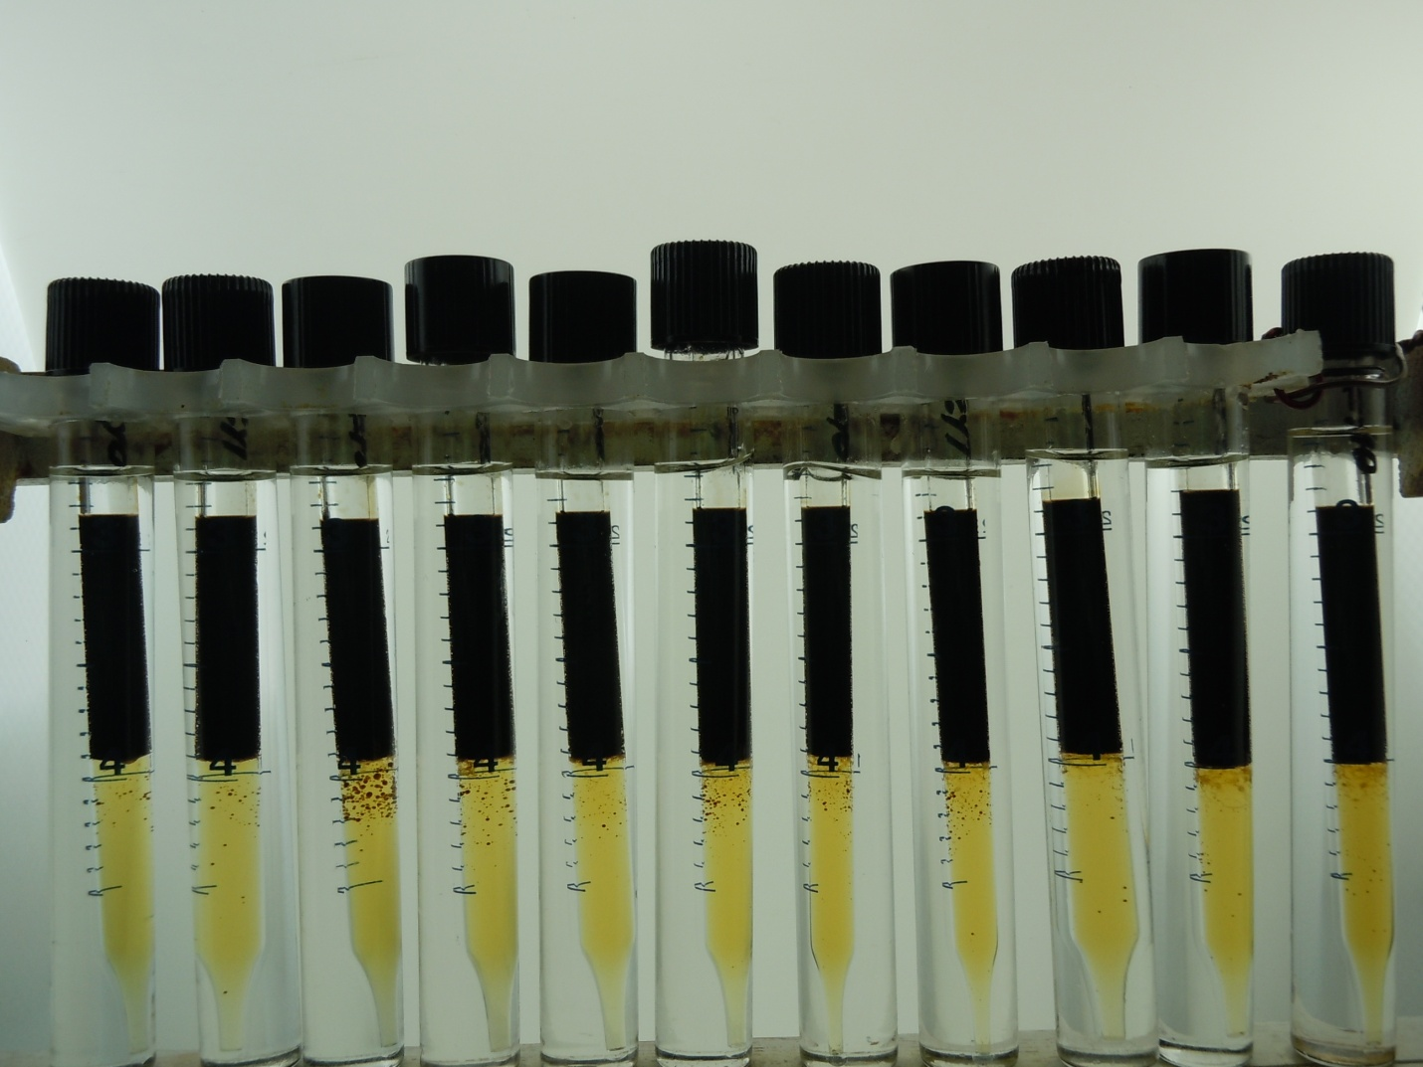
7:3 LB:AOS Salinity Scan from Injection Water to Formation Brine
2% Overall Surfactant Concentration. 60°C
Inj 9/1 8/2 7/3 6/4 5/5 4/6 3/7 2/8 1/9 FB
Winsor Type I:
Lower phase micro-emulsion

Slide 11
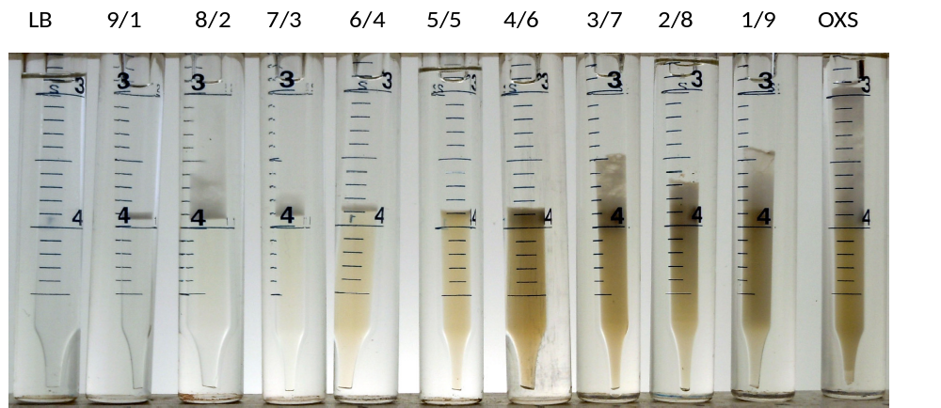
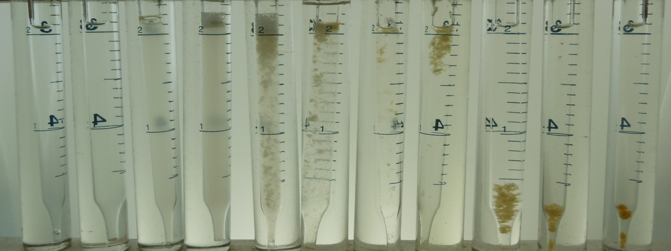
LB:OXS Blend Scan in Injection Water with n-Octane. 2% overall surfactant concentration
LB:OXS aqueous Blend Scan in Injection Water 1% surfactant concentration. 60°C
n-octane
aqueous
Winsor Type I:
Lower phase micro-emulsion

Slide 12
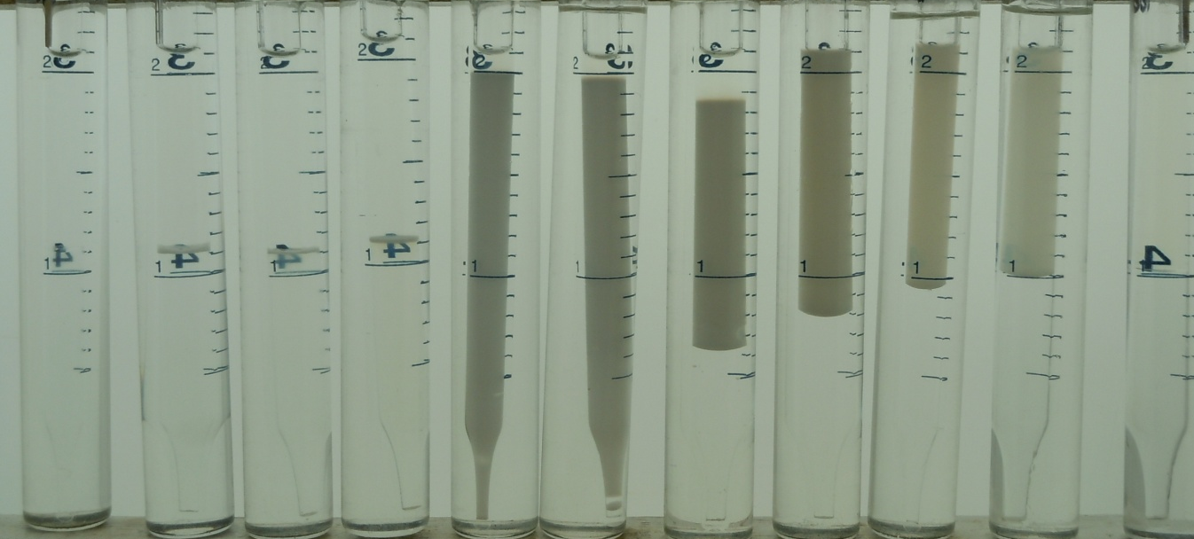
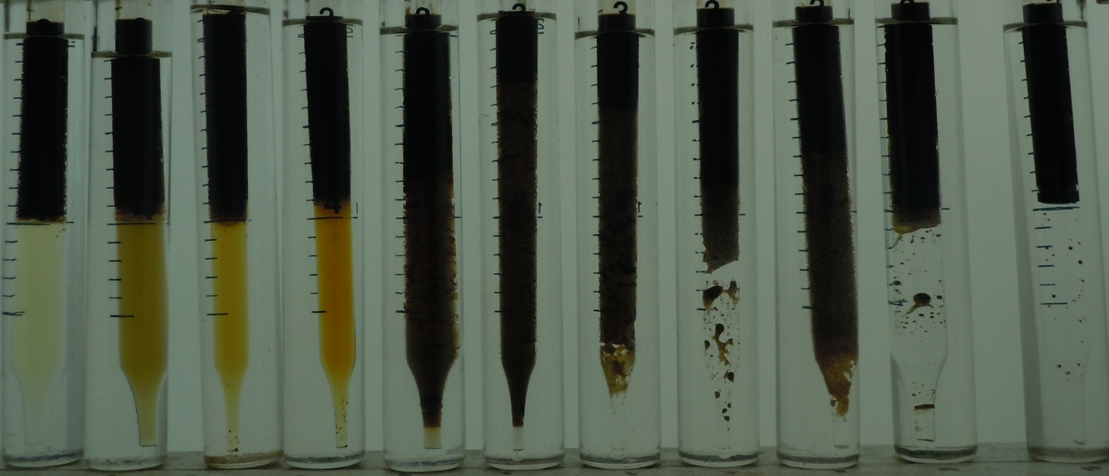
LB:A Blend Scan in Injection Water with n-Octane and crude oil.
2% overall surfactant concentration. WOR~1. 60°C
Winsor Type I:
Lower phase micro-emulsion
Winsor Type II:
Upper phase micro-emulsion
LB 9/1 8/2 7/3 6/4 5/5 4/6 3/7 2/8 1/9 A
LB 9/1 8/2 7/3 6/4 5/5 4/6 3/7 2/8 1/9 A

Slide 13
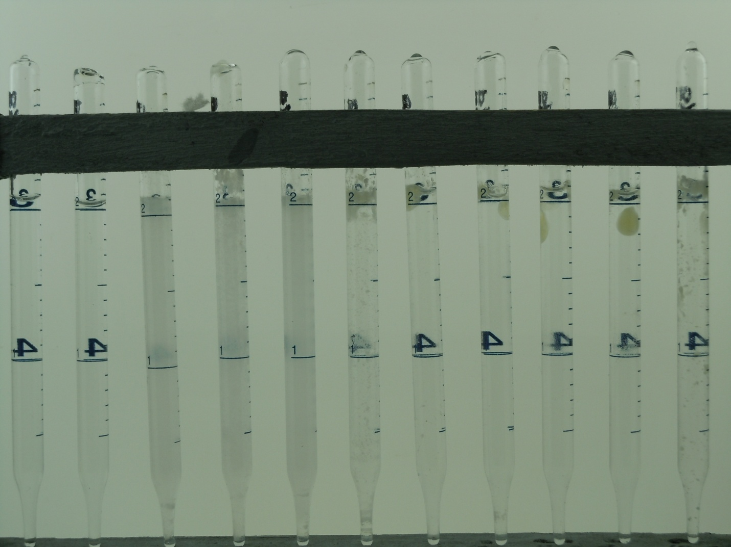
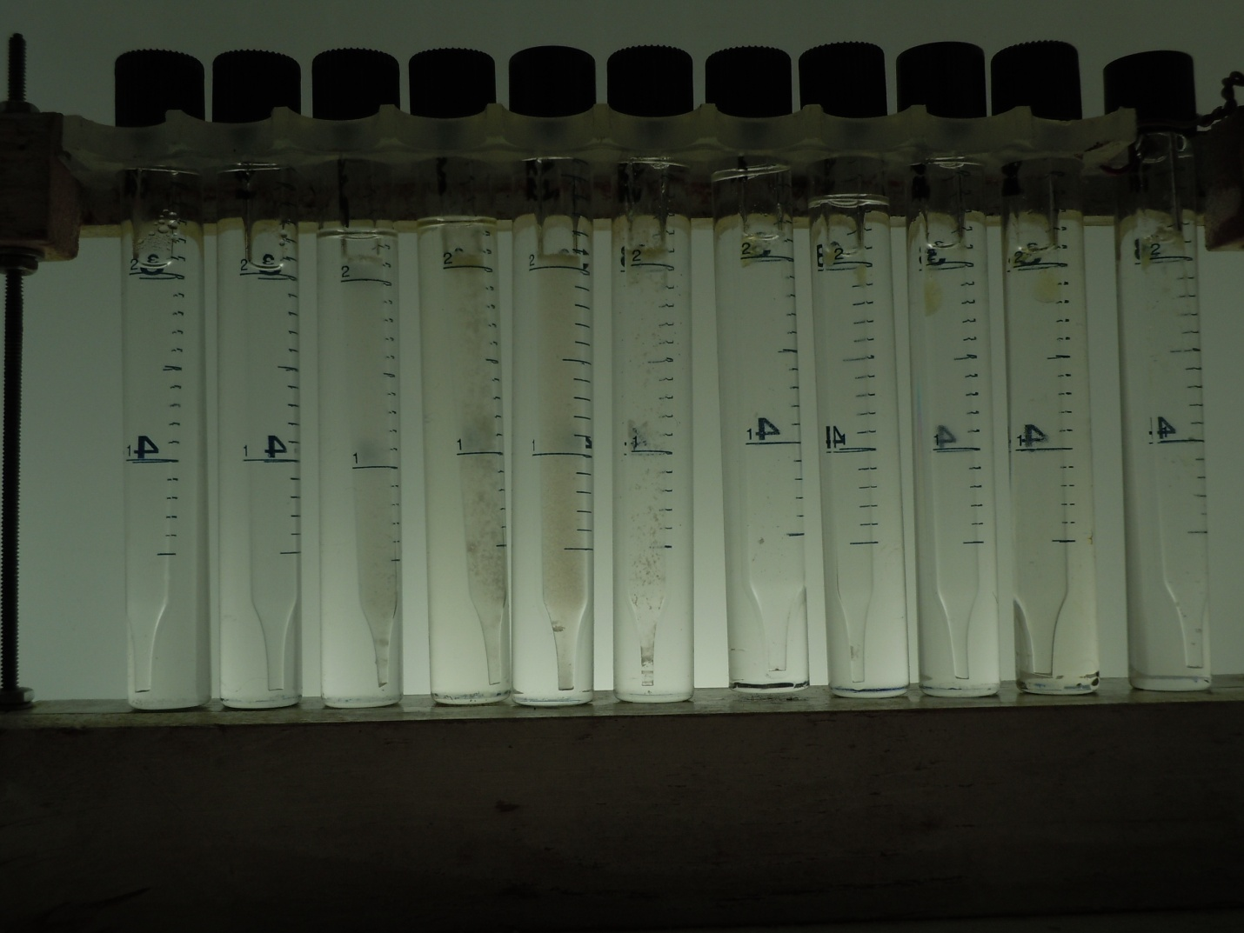
LB:A Surfactant Aqueous Blend Scan in Injection Water. 1% Overall Surfactant Concentration
Injection composition
LB 9/1 8/2 7/3 6/4 5/5 4/6 3/7 2/8 1/9 A
25°C
60°C

Slide 14
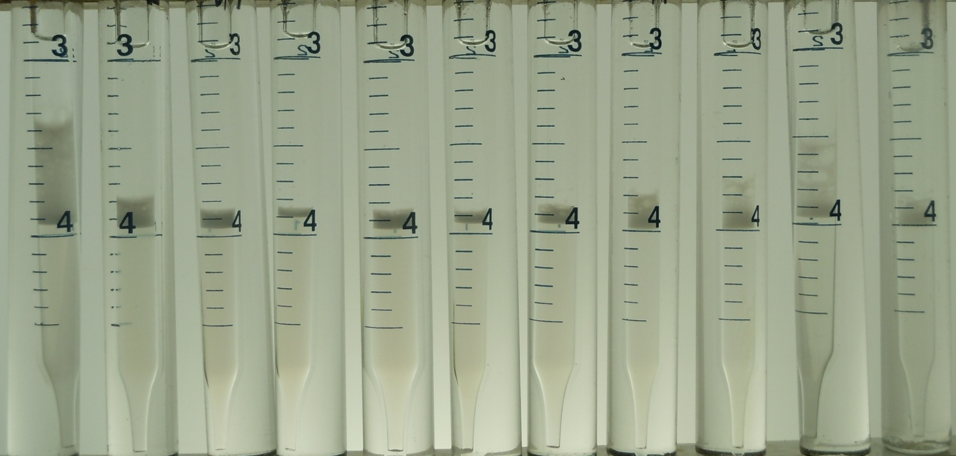
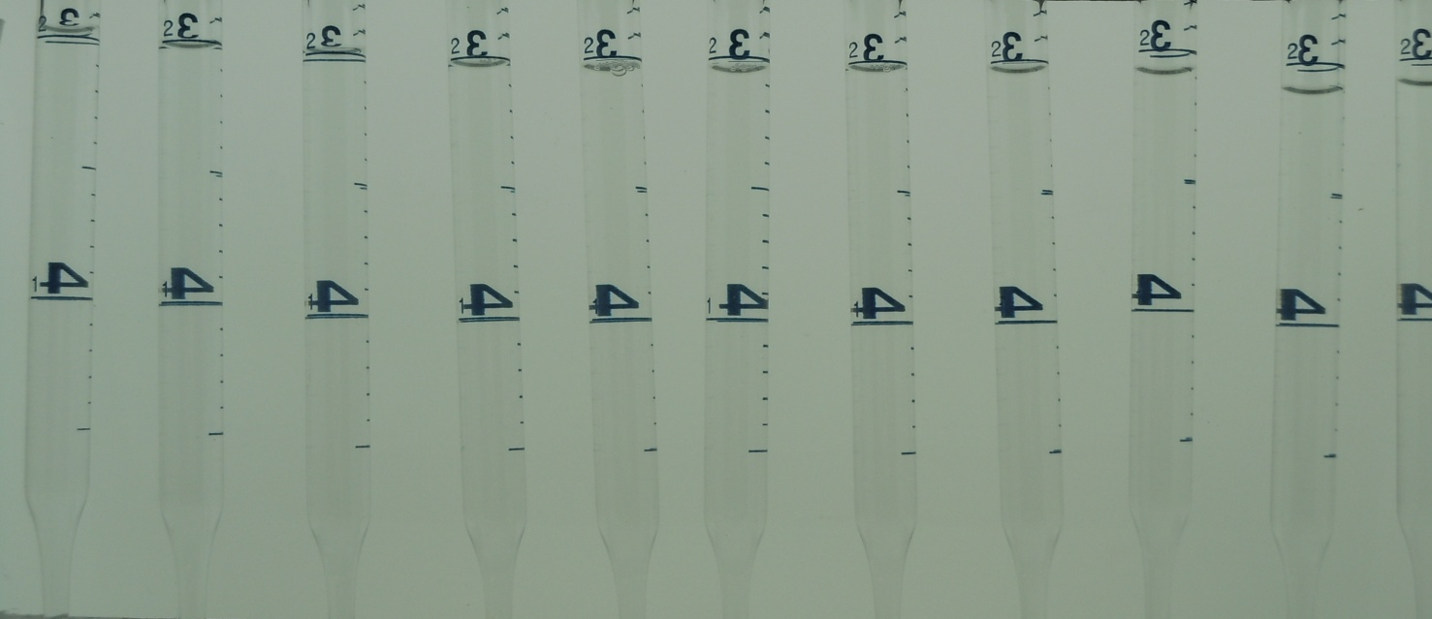
9:1 LB:A Salinity Scan from Injection Water to Formation Brine
2% Overall Surfactant Concentration. 60°C
Inj 9/1 8/2 7/3 6/4 5/5 4/6 3/7 2/8 1/9 FB
n-octane
aqueous
Winsor Type I:
Lower phase micro-emulsion

Slide 15
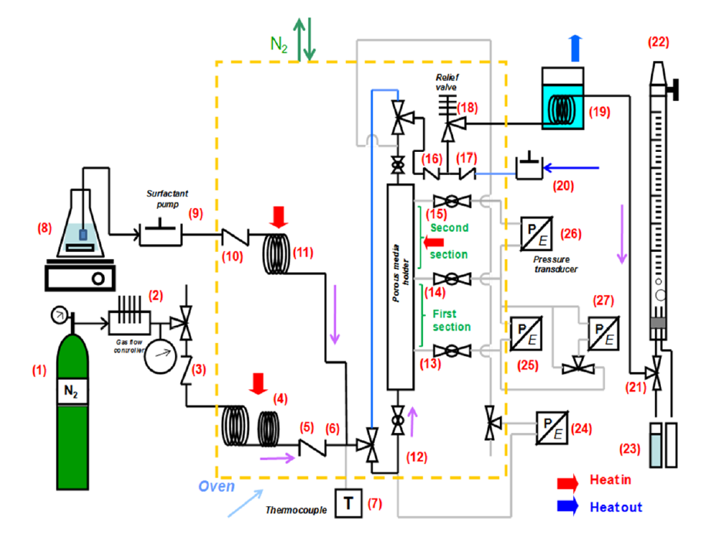
Dynamic Test: Homogenous 1-D Sand Pack
Transport of components and phases in a surfactant/foam EOR process for a giant carbonate Reservoir, PhD thesis 2012 by Jose Lopez.

Slide 16
Test results of AOS _{C14-16} in injection water
Injection condition: 0.2 ml/min surf + 0.8 Sccm³/min
Quality at steady state at test condition: 0.45 and 0.55 corresponding to 1st and 2nd internal tap
Apparent Viscosity at steady state: 800 and 630 cP corresponding to 1st and 2nd internal tap
Notes:
Test results of AOS C14-16 in injection water
Injection condition: 0.2 ml/min surf + 0.8 Sccm3/min
Quality at St.St at test condition: 0.45 and 0.55 corresponding to 1st and 2nd internal tap
Apparent Viscosity at St.St: 800 and 875 cP

Slide 17
Test results of LB:AOS_{C14-16} 7:3 in injection water
Injection condition: 1 ml/min surf + 10 Sccm3/min
Quality at steady state: 0.6 and 0.7 corresponding to 1st and 2nd internal tap
Apparent Vis at steady state: 200, 145 cP corresponding to 1st and 2nd internal tap

Slide 18
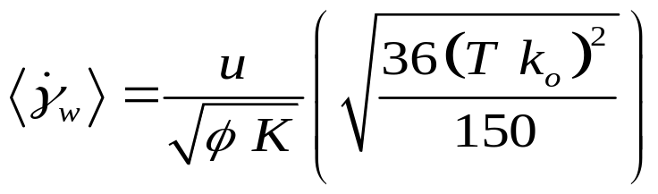
Shear Thinning effect; Comparison with other studies
Carreau, 1997
Rheology of polymeric systems
Addapted from Lopez, Thesis 2012

Slide 19
Shear Thinning effect; Comparison with other studies
Carreau, 1997
Rheology of polymeric systems
Addapted from Lopez, Thesis 2012

Slide 20
Conclusion and Future plans
LB:AOS_{C14-16} 7:3 is a clear solution at reservoir temperature and salinity
LB:A has an optimal blend ratio at injection salinity. This system could have a lower IFT between oil and brine than LB:AOS_{C14-16} system.
LB:AOS_{C14-16} 7:3 generates strong foam in reservoir temperature in absence of oil.
Future Plan
Investigate whether LB:A system has lower IFT between oil and brine than LB:AOS_{C14-16} system and also capable of generating strong foam
More foam tests with AOS _{C14-16} and LB:AOS_{C14-16} to find effect of quality, surfactant concentration and flow rate
Foam tests in presence of oil

Slide 21

Acknowledgement to our Sponsor:

